Slide 1
Topics
Angular Form
Form state and input state properties
Form validation
ng-messages
$watch-$apply-$digest
ng-model-options

Slide 2
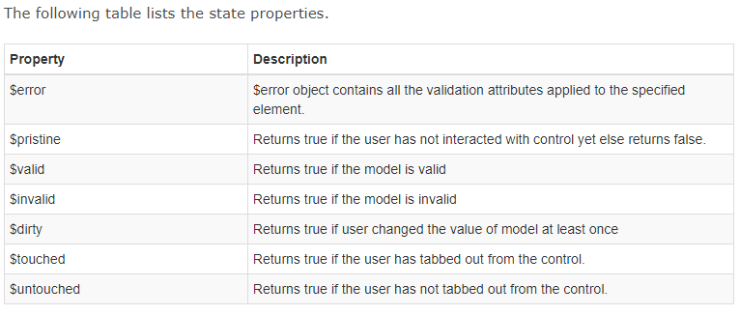
Form state and input state properties

Slide 3
Form validation
To check the form status use formName.propertyName,
To check the state of input control, use formName.inputFieldName.propertyName.

Slide 4
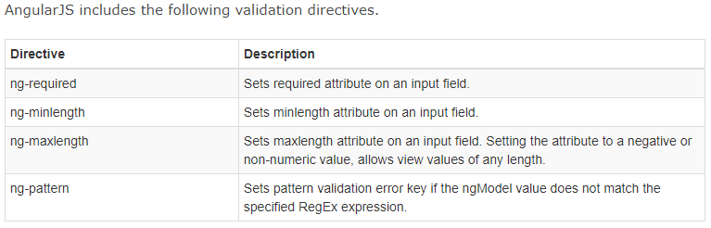
Validation directives

Slide 5
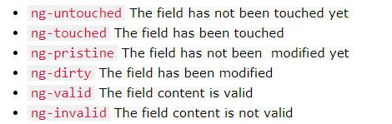
CSS classes

Slide 6
ng-messages
'ngMessages' module was rolled out with the release of Angular 1.3
The ngMessages module gives you the ability to display custom error messages to your users without writing repetitive code.
var myApp = angular.module("myApp",['ngMessages']);
<script src="js/angular-messages.min.js"></script>

Slide 7
ng-messages
<div ng-messages="form.username.$error">
<p ng-message="minlength">Username should have at least 6 characters.</p>
<p ng-message="maxlength">Username should have at most 12 characters.</p>
<p ng-message="required">Providing a username is mandatory.</p>
<p ng-message="pattern">Username can only be alphanumeric with an optional underscore.</p>
</div>
It loops through the $error object looking for a key that matches the values of any of the ng-message directives.

Slide 8
$watch(), $apply(), $digest()
Angular JS handles data -binding mechanism with the help of three powerful functions.
  $watch()
  $digest()
  $apply()

Slide 9
$watch() function
The $scope.$watch() function is used to observe changes in a variable on the $scope.
$watch() function takes two parametes.
  A value function
  A listener function
  $scope.$watch(function() { },
  function() { }
  );

Slide 10
$digest() function
The $scope.$digest() function iterates through all the watches in the $scope object
$digest() calls value function of each watch, and if there is a change in the value, the listener function of that watch is called.
As a result of this any expression in the view will get updated.

Slide 11
$apply() function
$apply() should be called , when you do changes in model data outside angular context.
When $apply() function call finishes angular js calls $digest() internally, so all data bindings are updated.

Slide 12
ng-model-options
The ng-model-options gives us control over how Angular updates and manipulates your model.
This includes customizing the model to update only after certain events are triggered or debouncing delay, so that the actual update takes place only when a timer expires.
ng-model-options="{ updateOn: 'blur' }"
ng-model-options="{ updateOn: 'blur mouseover' }"
ng-model-options="{ updateOn: 'blur', debounce: { 'blur': 0} }"

